Slide 1
QUANTUM SHARDULA, MEASUREMENT PROBLEM AND GRAVITATIONAL WAVE DETECTION
PATRICK DAS GUPTA
Formerly at the Department of Physics and Astrophysics, University of Delhi
A. N. MITRA MEMORIAL MEETING AND LECTURE,
April 14-15, 2025.

Slide 2
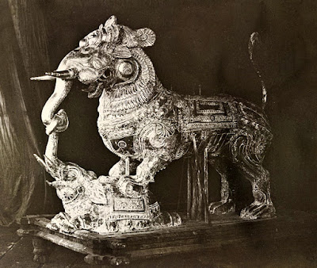
Image Credit:
https://www.bibhudevmisra.com/2019/02/the-yali-symbol-on-indus-seal-and-its.htm
SHARDULA : Superposition of distinct animals

Slide 3
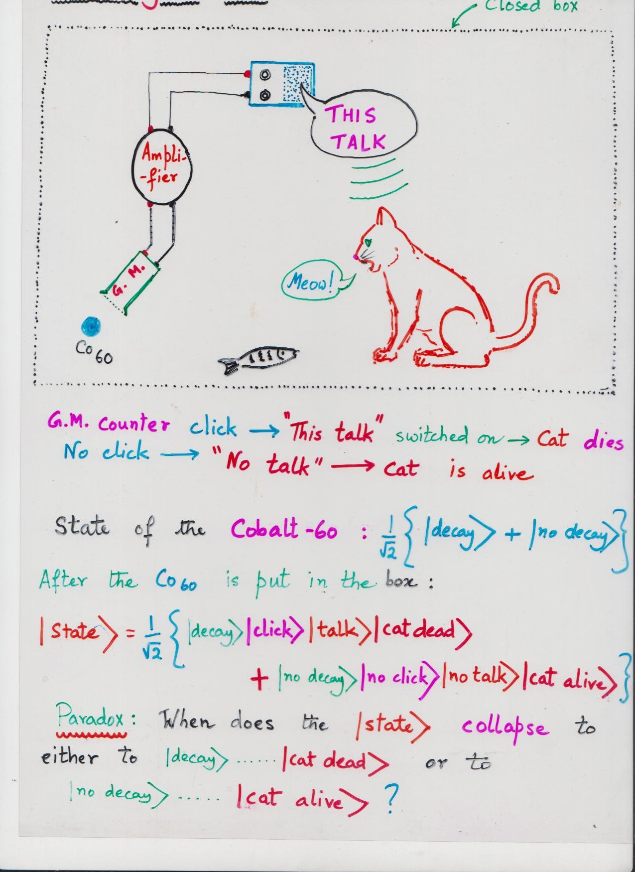

Slide 4
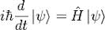
IN THE ABSENCE OF ANY
MEASUREMENT, THE
STATE EVOLVES
ACCORDING TO THE
SCHRODINGER’S
EQUATION, IN A
DETERMINISTIC WAY

Slide 5
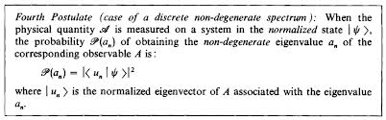
* A MEASUREMENT TAKES PLACE WHEN AN APPARATUS INTERACTS WITH THE SYSTEM UNDER OBSERVATION
* THIS INTERACTION IS REPRESENTED BY AN INTERACTION HAMILTONIAN
* APPARATUS + SYSTEM SHOULD EVOLVE ACCORDING TO SCHRODINGER EQUATION

Slide 6
THE INTERACTION BETWEEN THE SYSTEM UNDER OBSERVATION AND THE APPARATUS LEADS TO:
* AN ENTANGLEMENT BETWEEN THE STATES OF THE SYSTEM AND THE APPARATUS
* EXCHANGE OF ENERGY BETWEEN THE SYSTEM’S FEW DEGREES OF FREEDOM AND INNUMERABLE DEGREES OF FREEDOM OF THE APPARATUS →
(a) Energy-time uncertainty
(b) Energy fluctuation → General relativity → Metric fluctuation → Fluctuation in the proper time
(c) Increase in Entropy
* GRAVITY AND QUANTUM THEORY: Is there a Planck number of degrees of freedom?
Planck mass/electron mass ~ 10^(22)

Slide 7
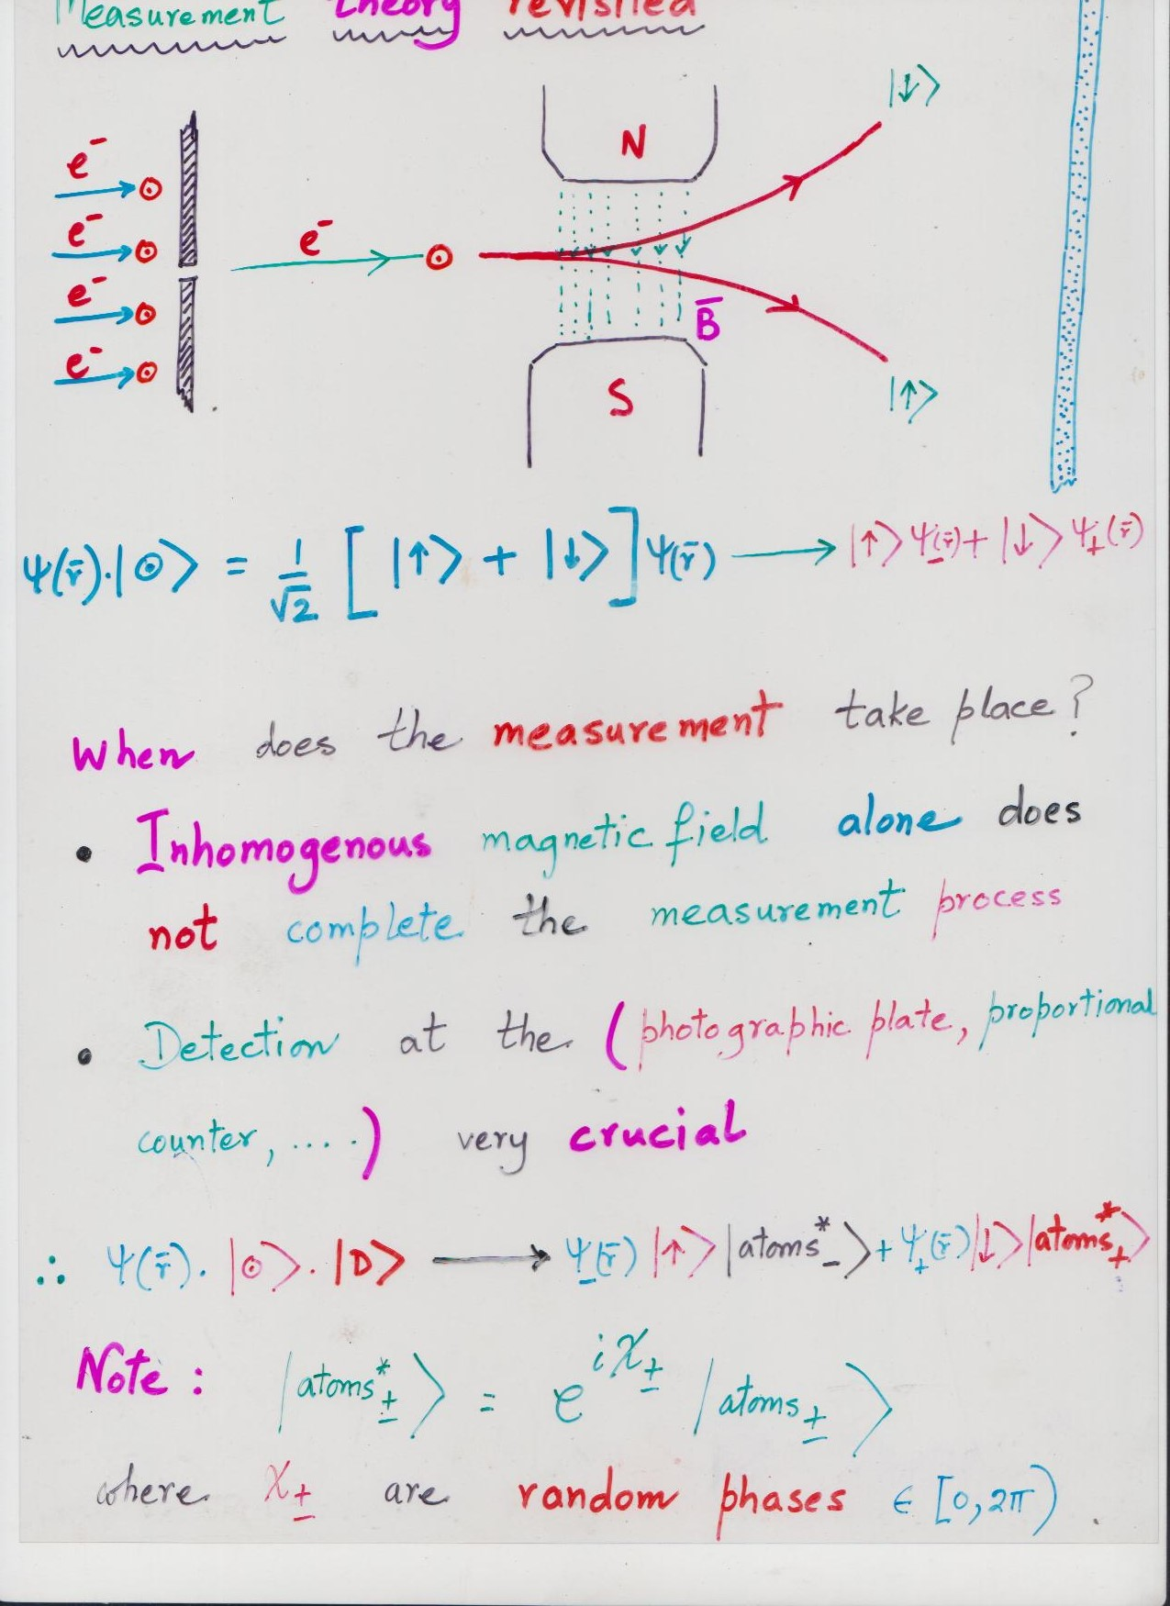

Slide 8
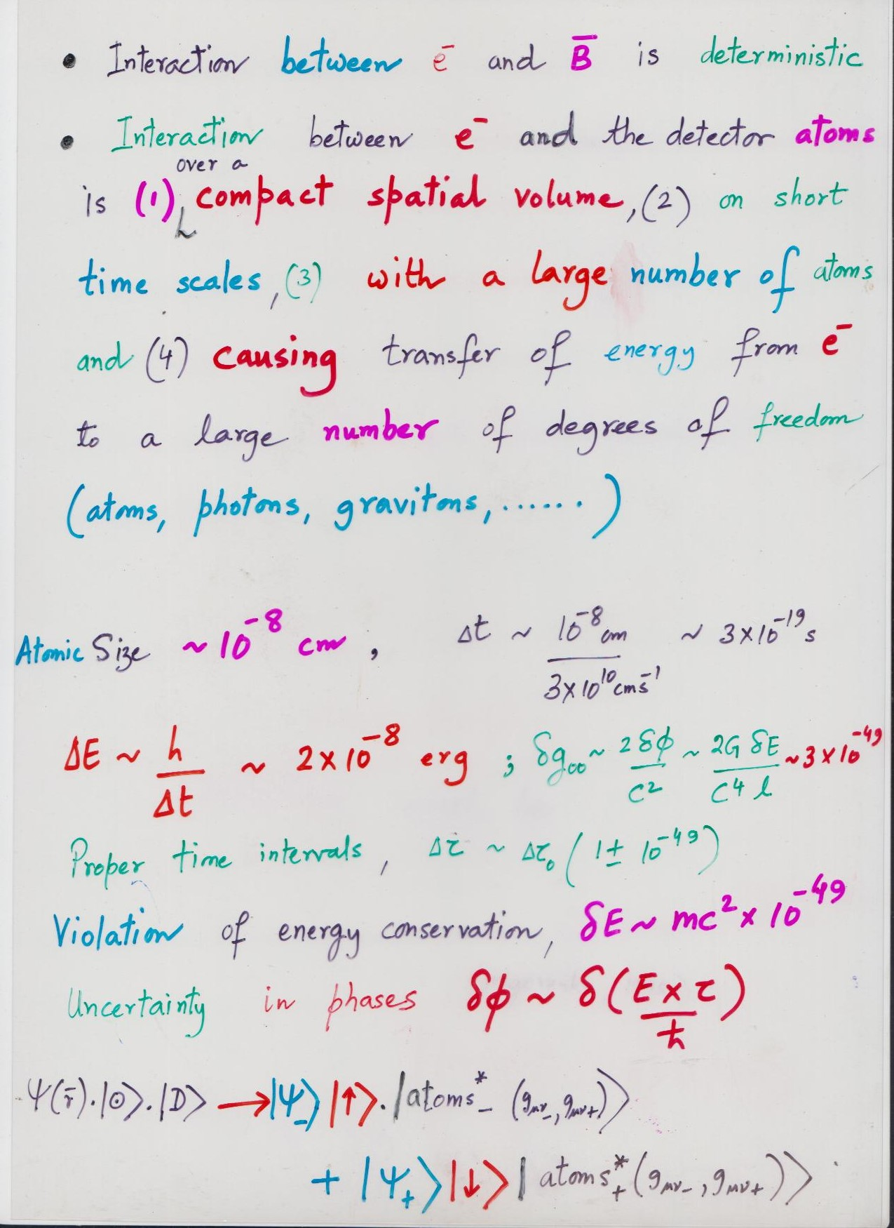

Slide 9
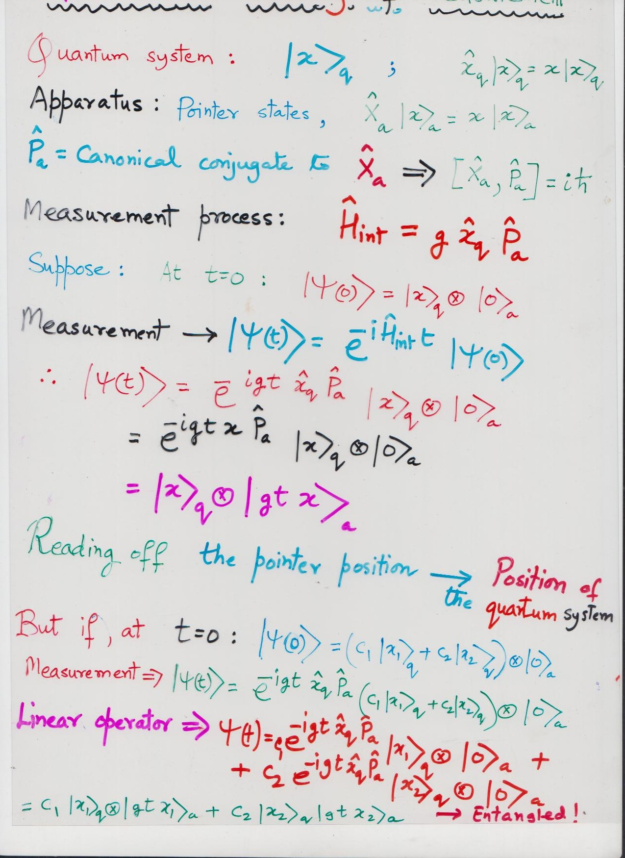

Slide 10
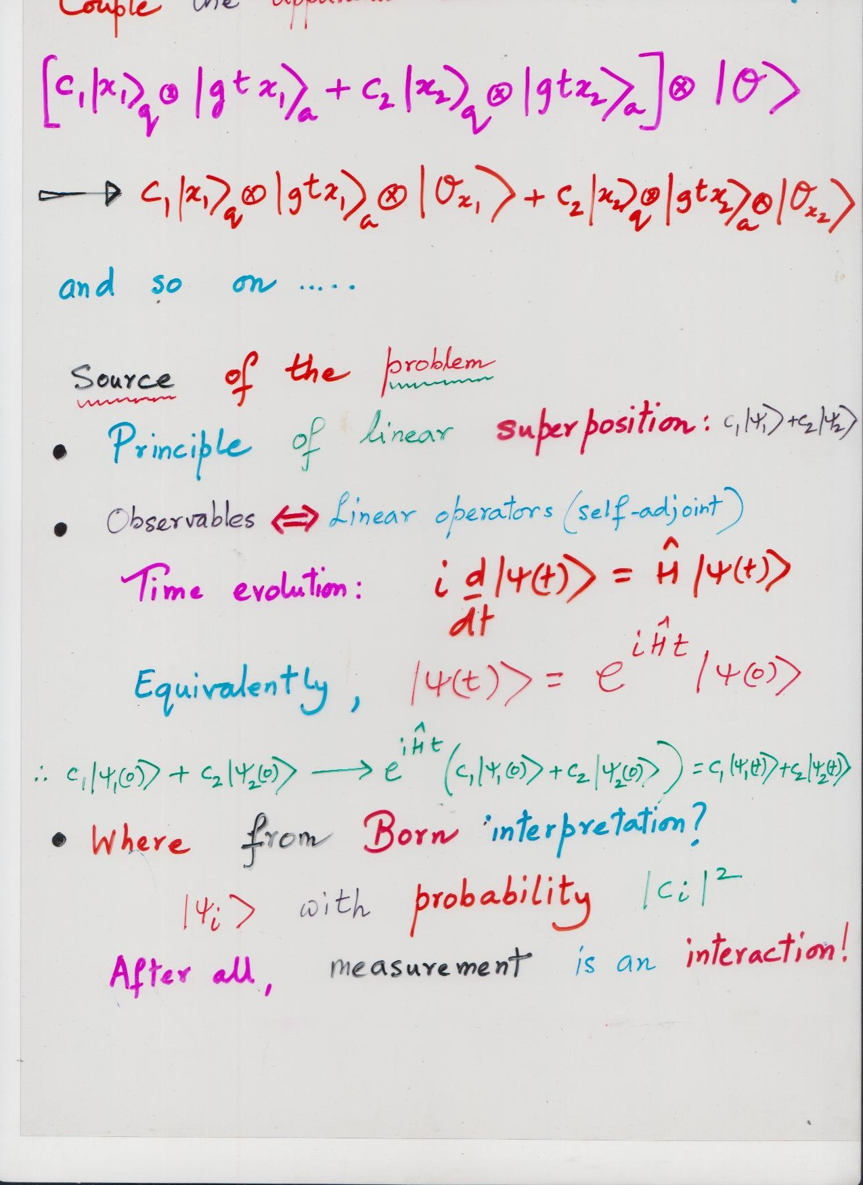

Slide 11
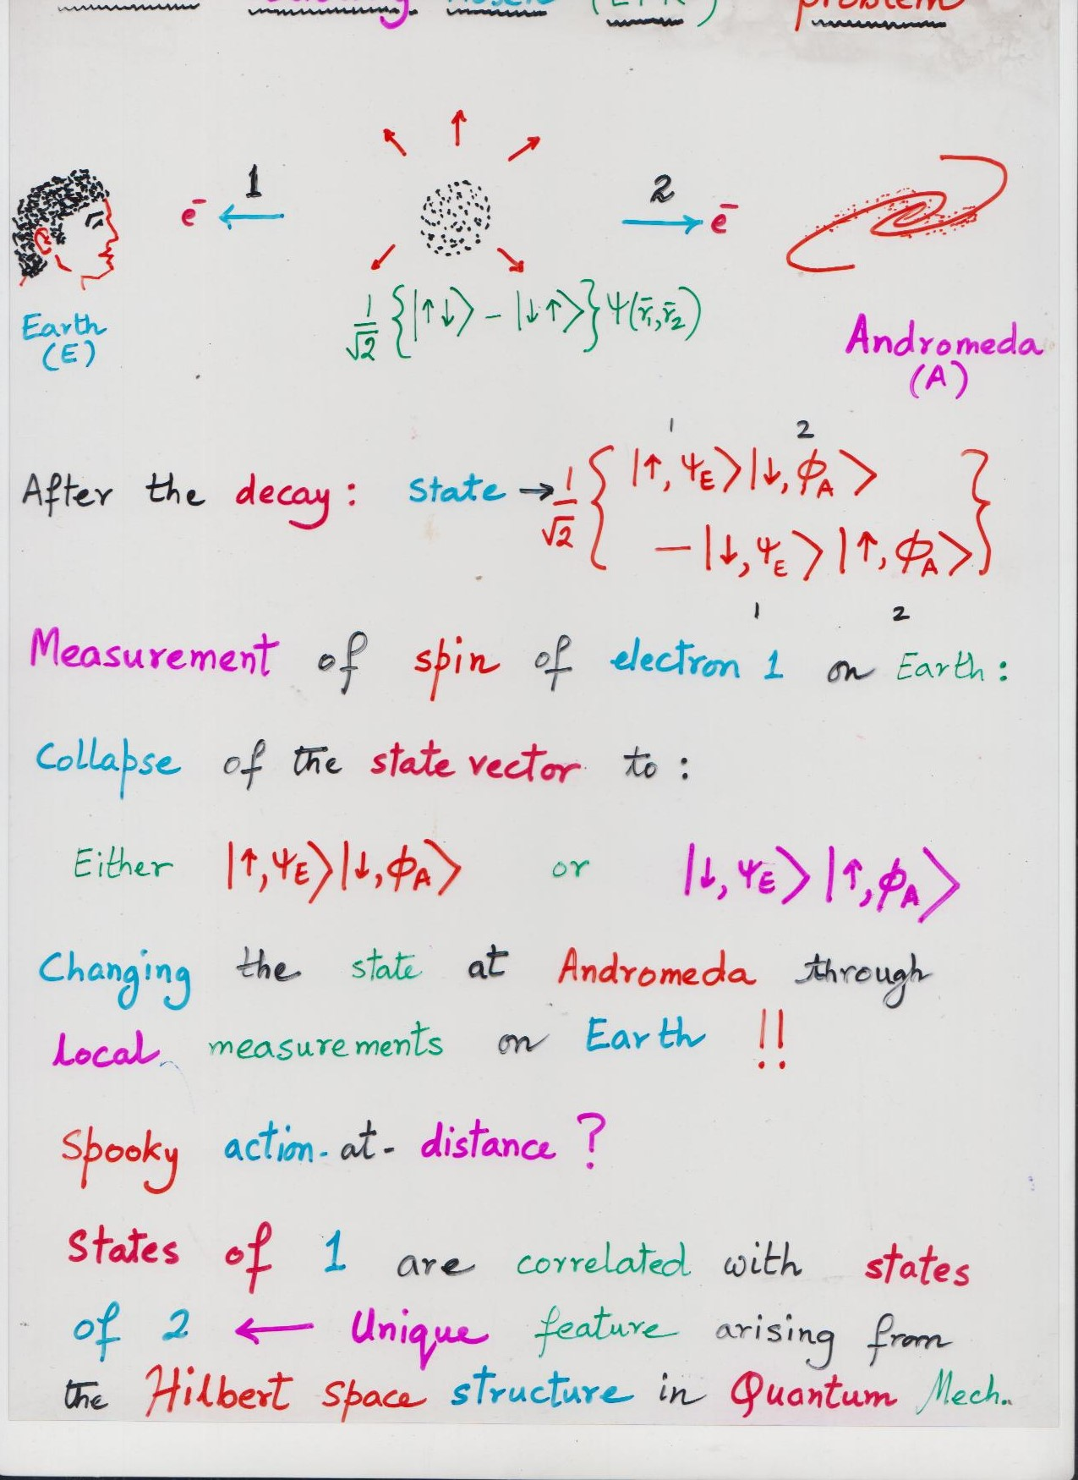

Slide 12
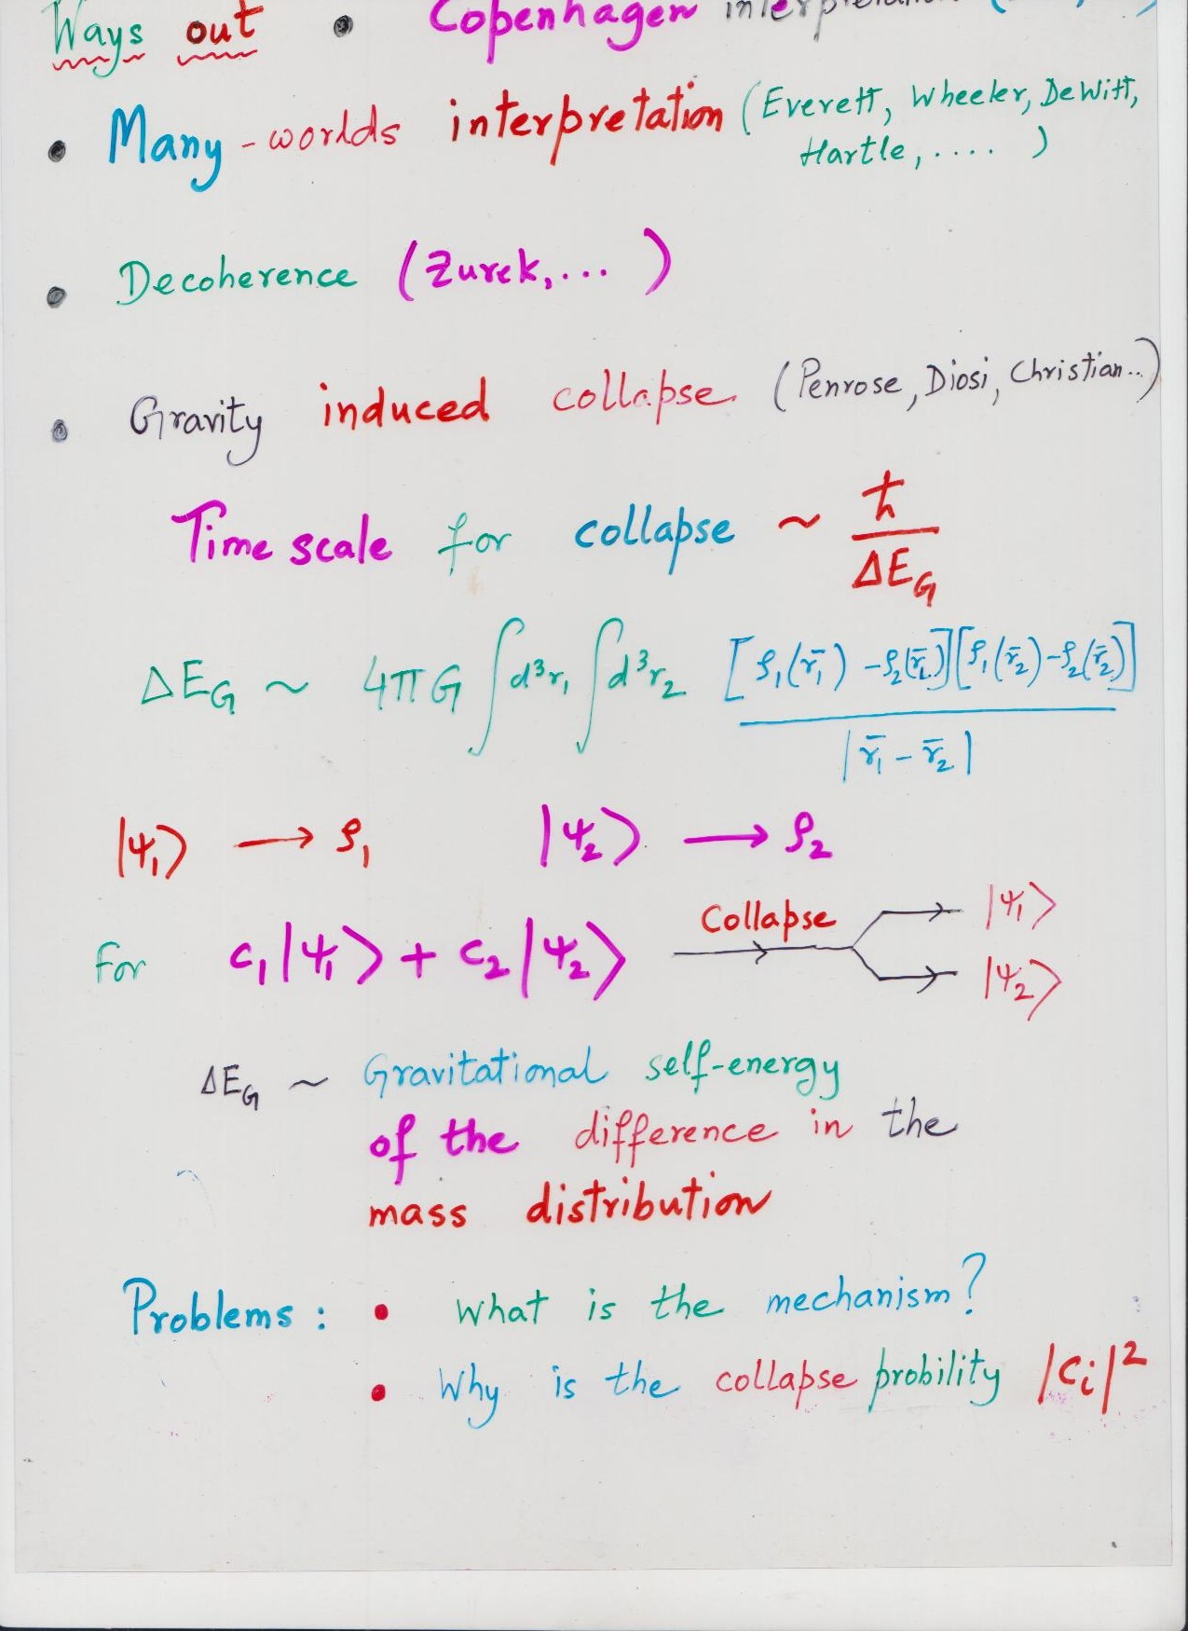

Slide 13
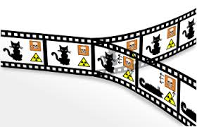
Many Worlds Theory :
But, what about Born rule?

Slide 14
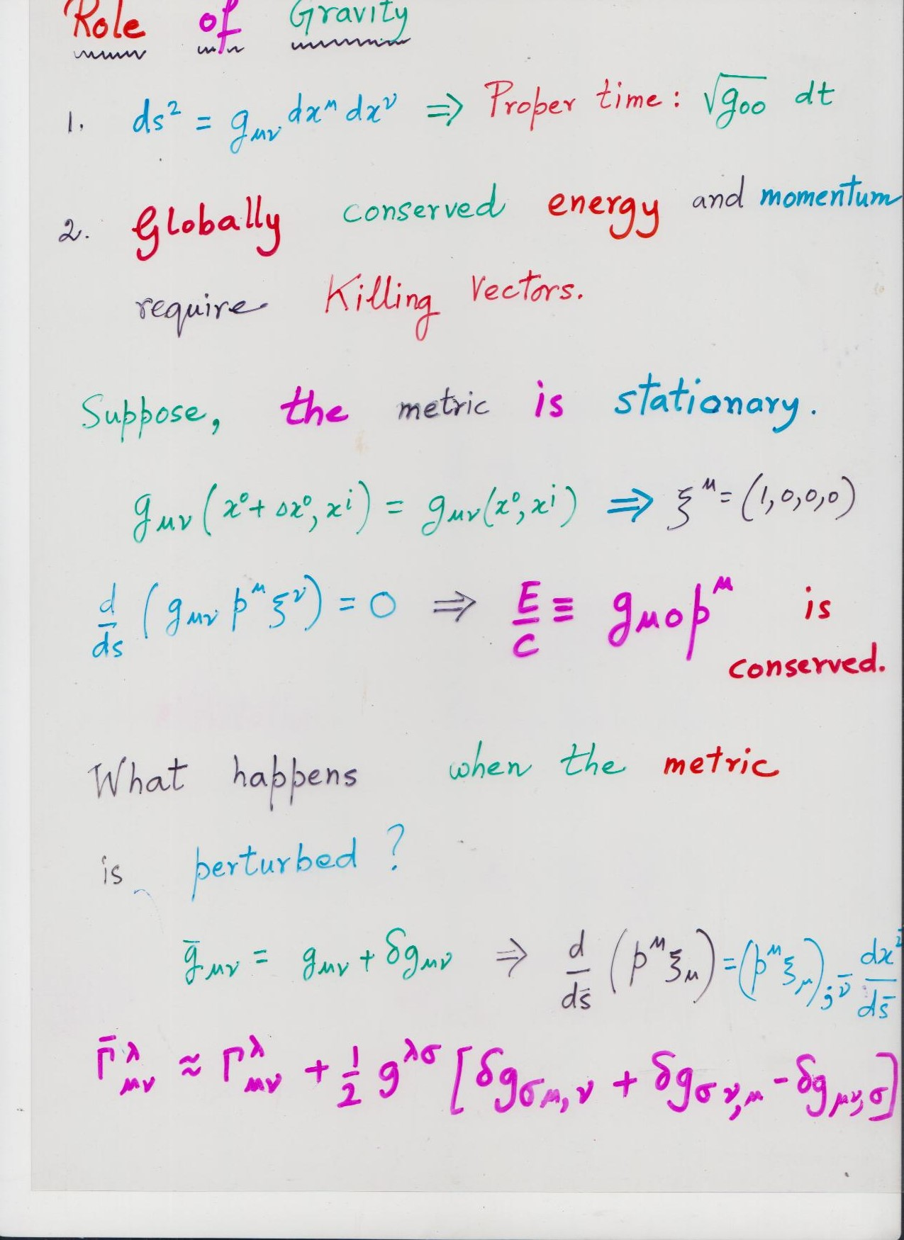

Slide 15
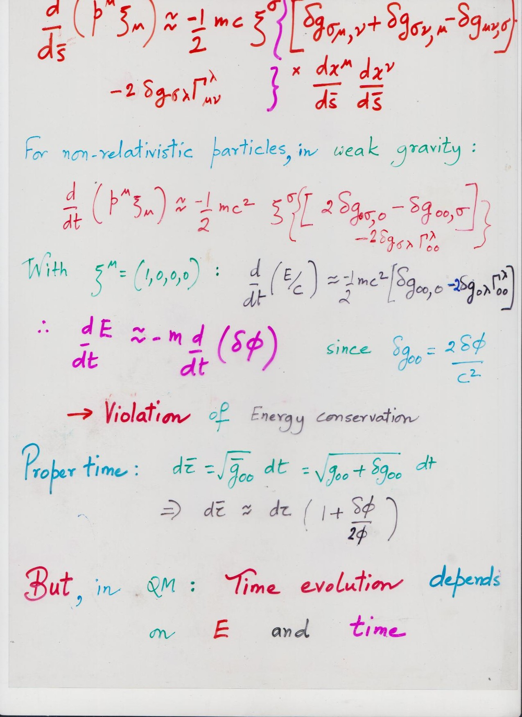

Slide 16
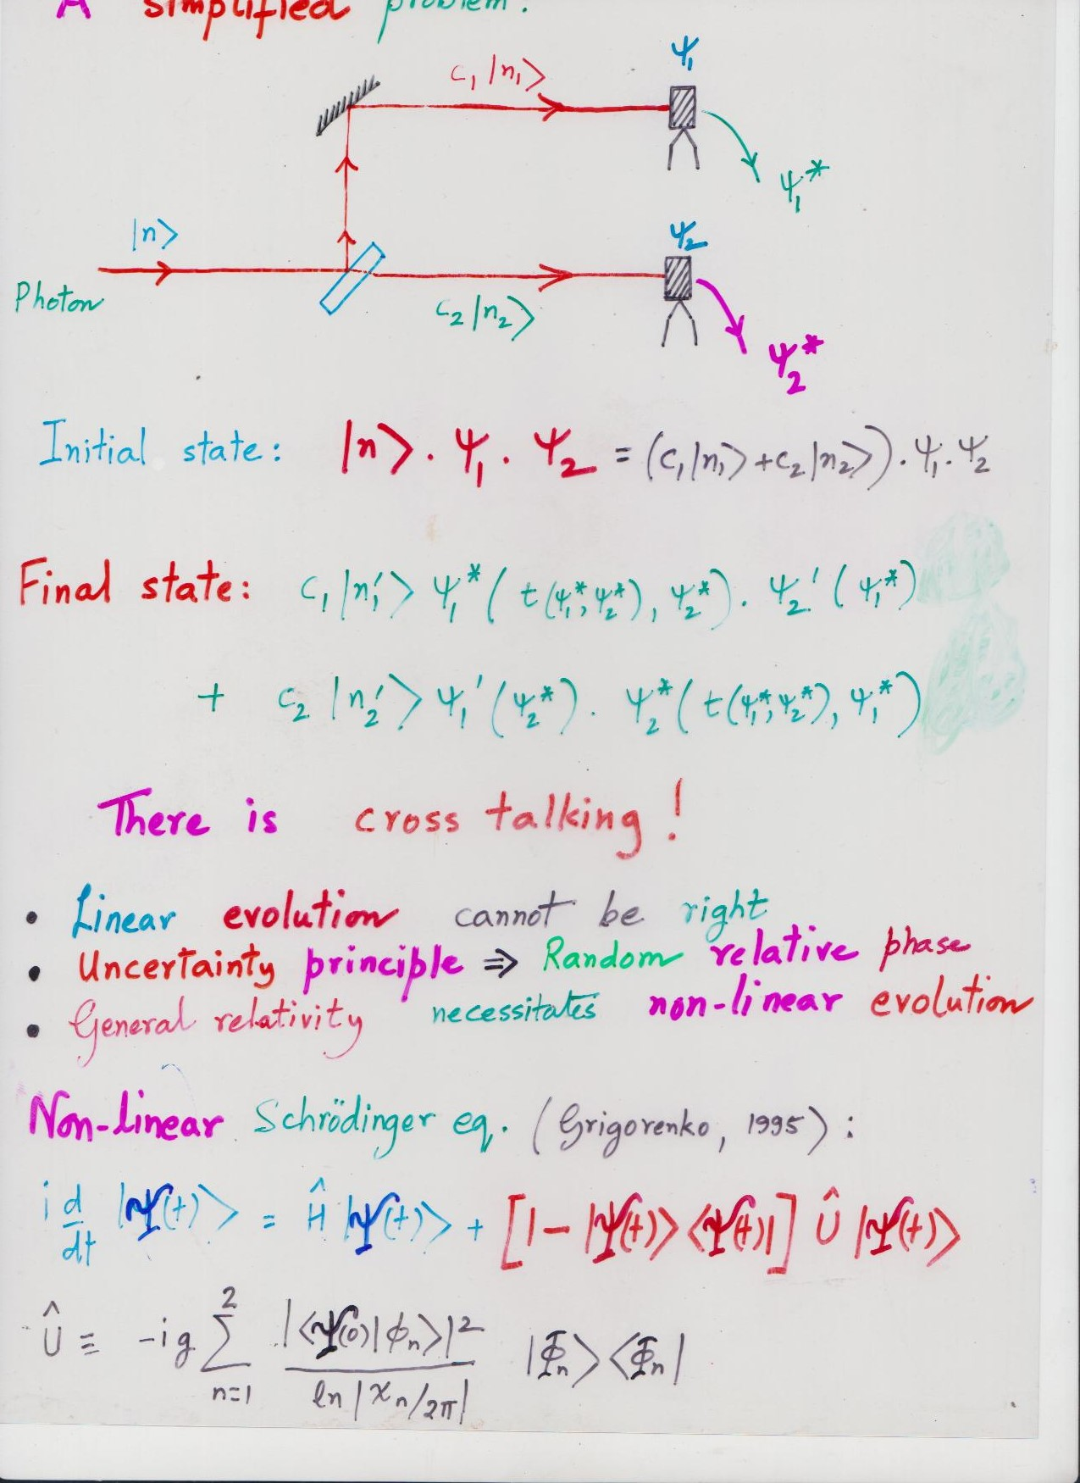

Slide 17
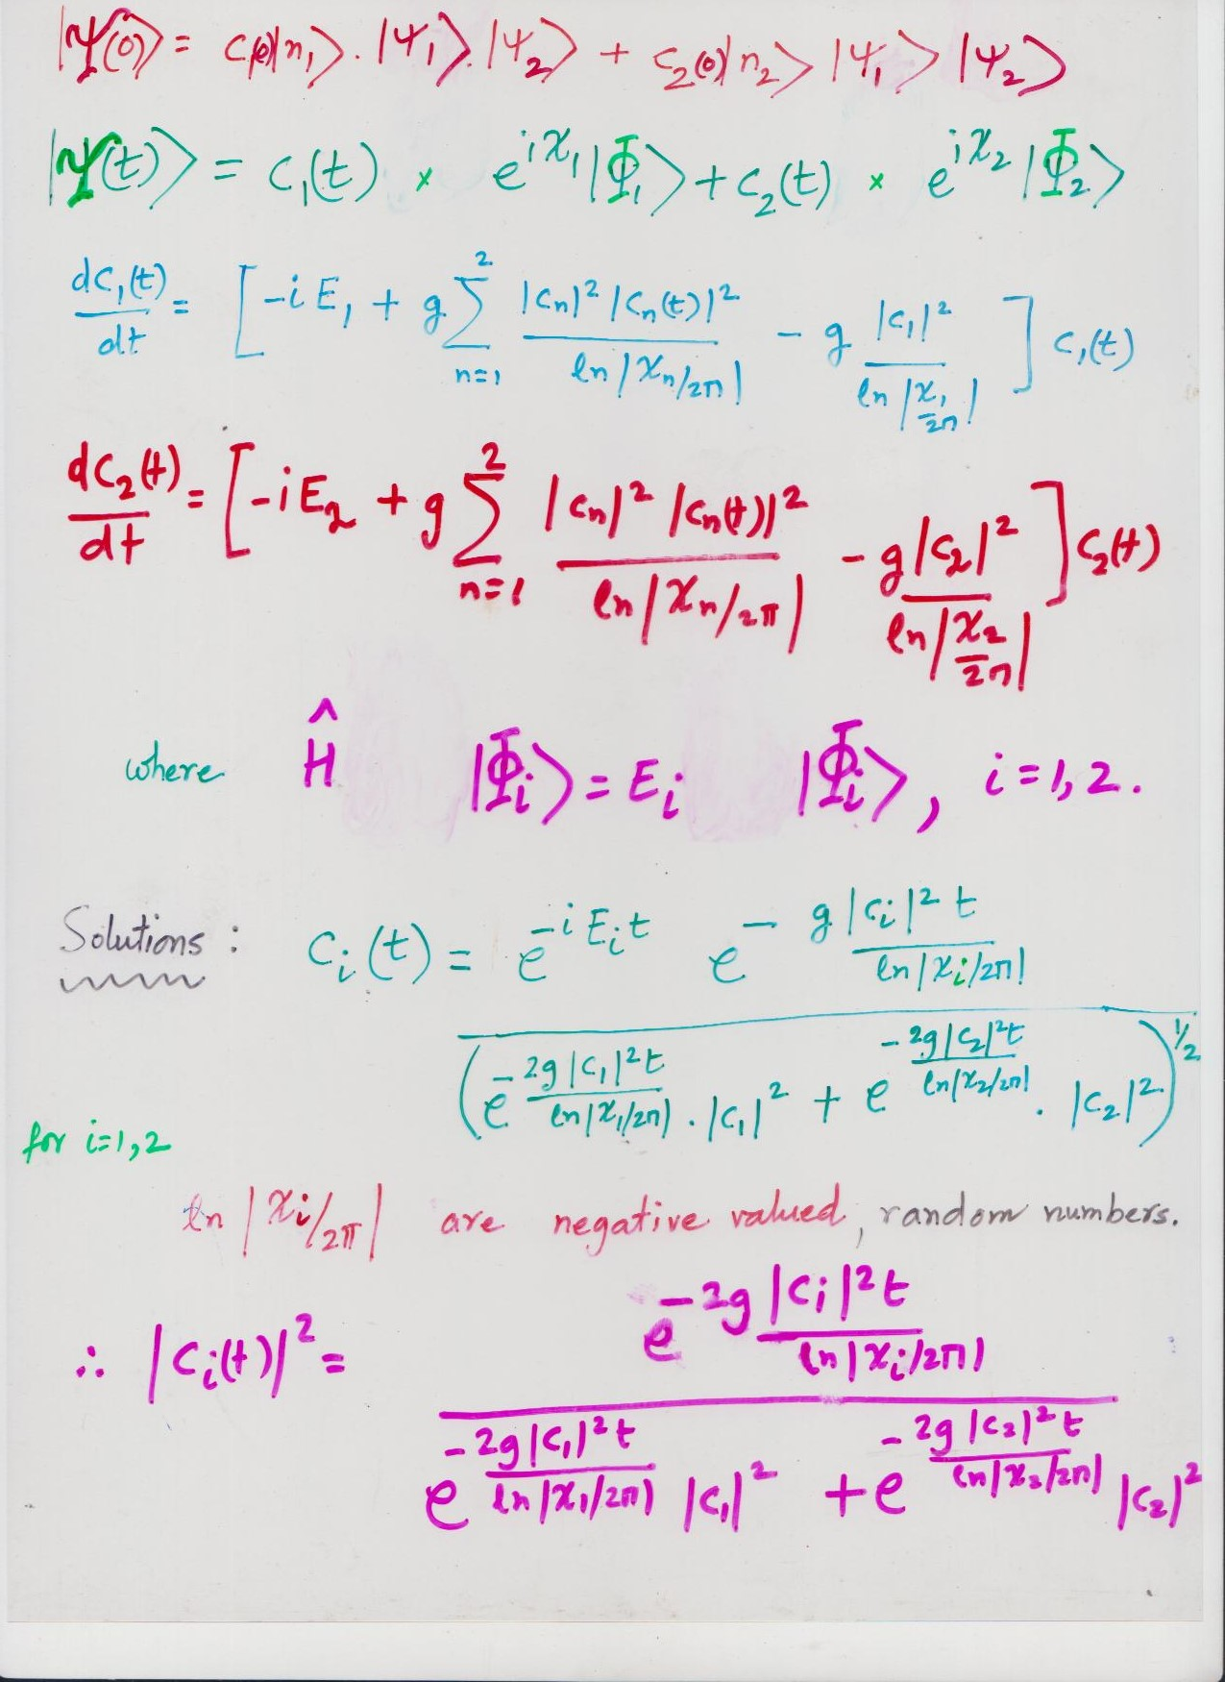

Slide 18
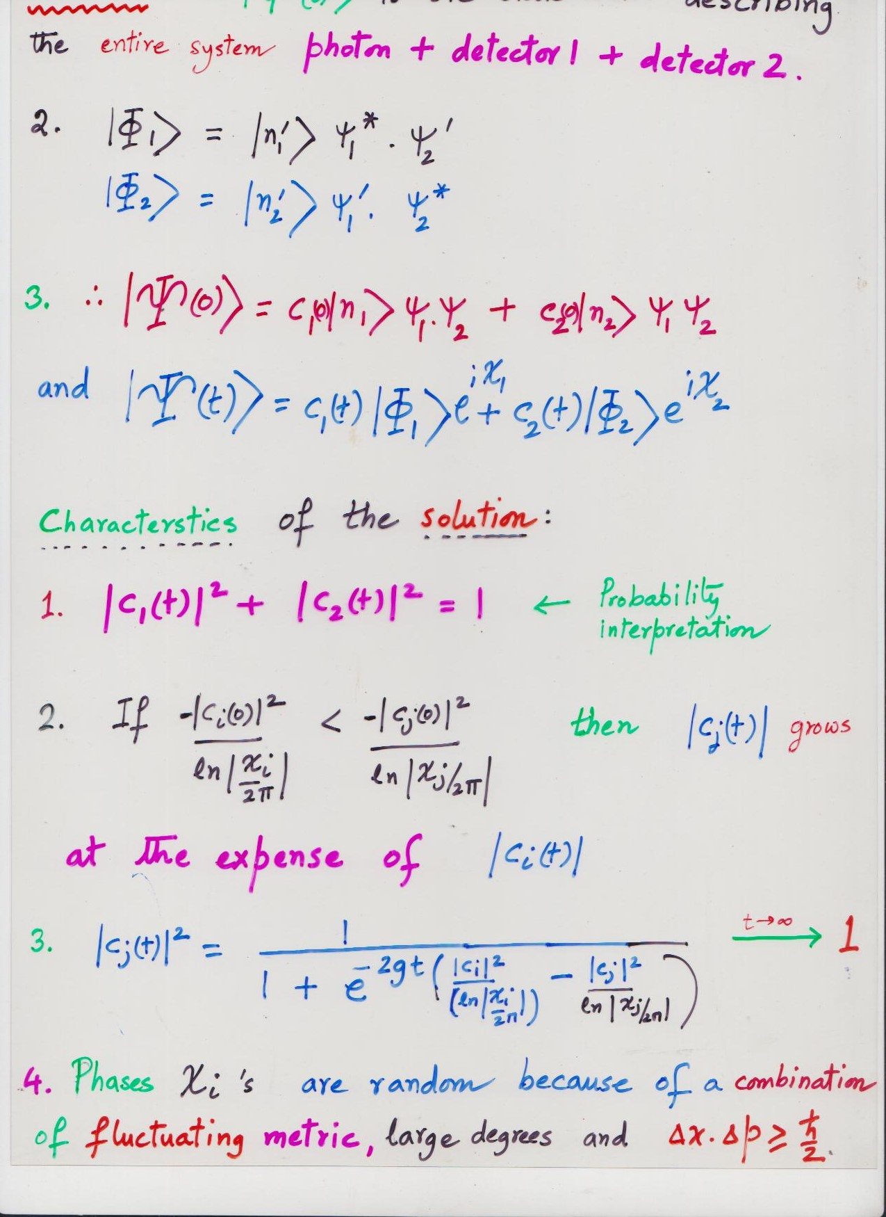

Slide 19
Quantum Gravity effects and gravitational wave (GW) detectors
(Amelino-Camelia (1999);…; Dyson (2013); …; Parikh, Wilczek and Zahariade, Phys. Rev.Lett. (2021);….)
* Quantum GW effects on the geodesic deviation equation
* Characteristic Quantum GW noise and LIGO
The noise depends on the specific quantum state of the GW

Slide 20
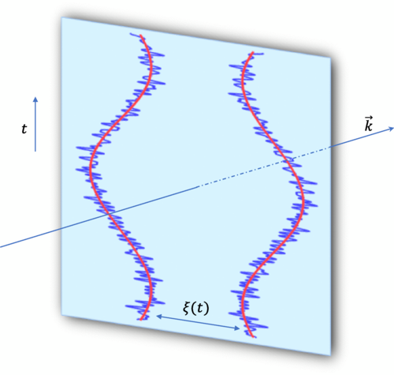
Gravitational Wave Quantum effects on the separation between two geodesics
Image Credit:
Parikh, Wilczek and
Zahariade, Phys. Rev. Lett., 2021)

Slide 21


